Slide 1
Predicting ETF Price Movements Using Market Factors
Author:
Chan Nok Hang 312707025

Slide 2


Motivation
S&P 500, reflects the overall health and performance of the U.S. stock market. Investing in an ETF that tracks the S&P 500 provides exposure to a diversified portfolio of major corporations, making it an attractive investment option.
Interest in apply Machine Learning techniques to support the investment decision making on S&P 500 tracing ETF.

Slide 3


Data Collection
Time Period: 2019 to 2023/11/1
1. daily treasury rates 2019-2023/11/1
2. daily treasury long term rates 2019-2023/11/1
3. daily treasury real long term rates 2019-2023/11/1
4. S&P500: 2019/11/4 to 2023/11/1
5. SPY: 2019/11/4 to 2023/11/1
6. SPLG: 2019/11/4 to 2023/11/1
7. technical indicator: e.g. EMA,MACD,RSI,DMI

Slide 4
Data Preprocessing
-sort and merge
Data are separated:
18 separate data files
->split and merge into 3 dataframe (etfpred,treasury_rates, technical indicators)
->merge into 1 file

Slide 5
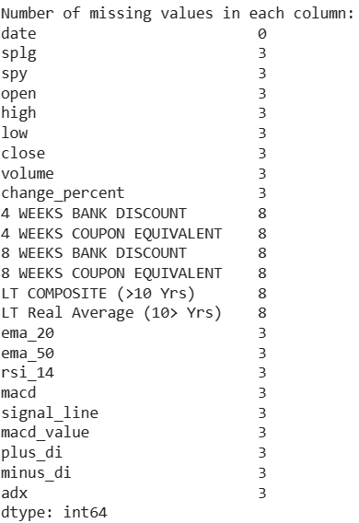
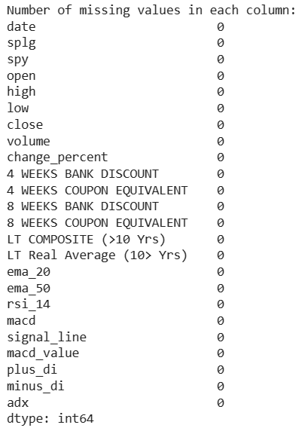
Data Preprocessing-sort and merge
outer 1009 rows
inner 998 rows
No duplicate
No missing

Slide 6
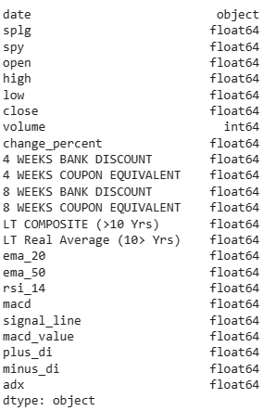
Data Preprocessing
-sort and merge
Dataframe Shape:
(998, 24)

Slide 7
Exploratory Data
Analysis

Slide 8
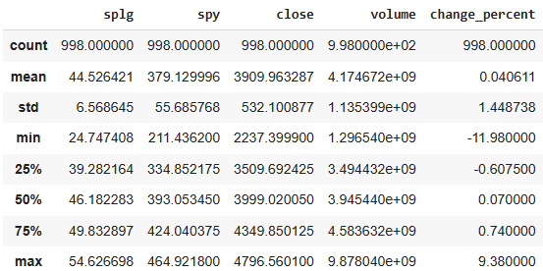
EDA
-Summary statistics
50% of SPLG daily price is
> $46.182283
50% of S&P 500 daily price change is
> 0.070%

Slide 9
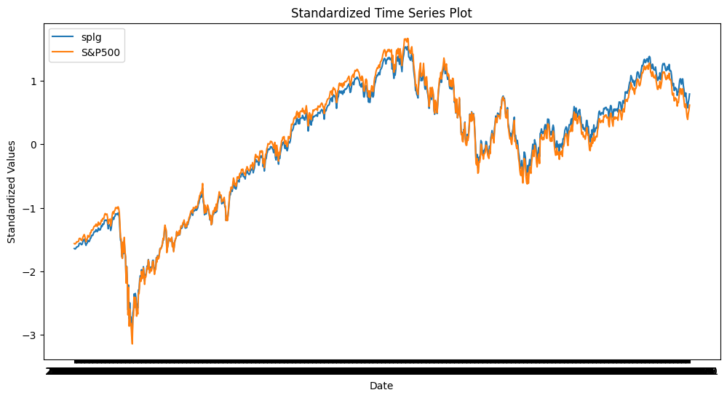
EDA-Time Series Plot
TS plot show their trend, standardize the price to same scale for compare
SPLG(index tracing ETF):
approximately same trend,
may represent highly correlated

Slide 10
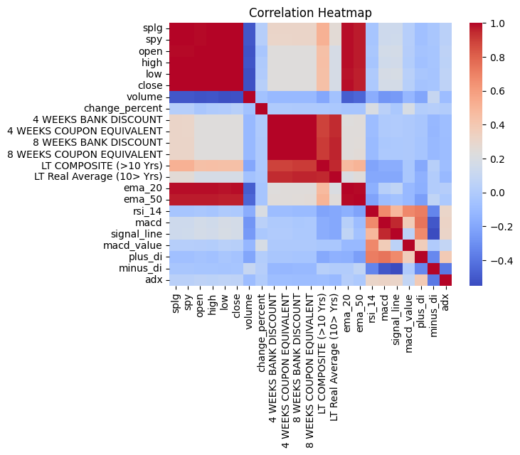
EDA
-Correlation

Slide 11
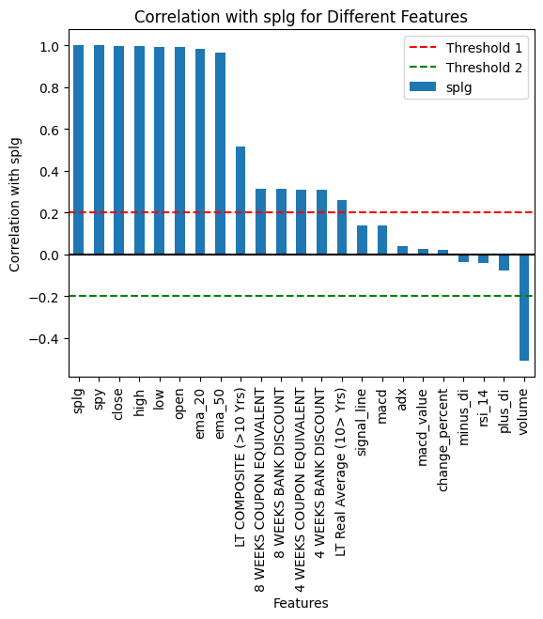
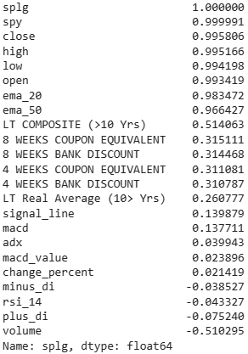
EDA-Correlation
Set threshold of e.g. ±0.2. If more than ±0.2 consider it have certain relation with SPLG, can use it in model

Slide 12
EDA
-Summary
From time series plot, correlation heatmap and correlation bar chart: SPLG, SPY is tracing S&P 500, most data of these three variables are highly positive correlated as expected.
Only volume in S&P 500 are negatively correlated to SPLG daily price.
Treasury rates of different time period indeed having positive correlation with SPLG, but not as much as other data.
If setting threshold e.g. ±0.2, suggest that technical indicators calculated by using S&P 500 data may consider as not correlated under this threshold.

Slide 13
Feature Selection

Slide 14
Feature Selection
22 features to choose and to build Machine Learning model
Split into 3 parts:
1. SPY and S&P500
2. treasury rates
3. technical indicators

Slide 15
Feature Selection
All features into 3 parts: SPY and S&P500, treasury rates, technical indicators
Total 7 combination:
All features
SPY and S&P500 + treasury rates
SPY and S&P500 + technical indicators
treasury rates + technical indicators
Only SPY and S&P500
Only treasury rates
Only technical indicators

Slide 16
Modeling

Slide 17
Modeling
Project Aim
Predict ETF Price Movements
HOW to archive?
Predict the price direction labels
WHAT to do?
Create price direction labels by using SPLG price data(1 for price increased next day/0 for decreased)
Build a classification model

Slide 18
Modeling
-Machine Learning Models
Logistic Regression:
Linear model used for binary classification.
Captures the relationship between predictor variables and the binary outcome.
Random Forest:
Ensemble method combining multiple decision trees.
Effective for classification tasks and provides feature importance.
AdaBoost:
Boosting algorithm that combines weak learners into a strong learner.
Focuses on misclassified instances to improve overall performance.

Slide 19
Modeling
-Training and Evaluation
Training
Data Splitting:
Employed train-test split
test size=0.3, random_state=42
300 days test data
Train-test split for initial model evaluation.
Model Performance Metrics
Accuracy:
Measures the overall correctness of predictions.
Evaluation
10-fold cross-validation:
Cross-validation for robustness, assessing performance across various data subsets.
Chose the final model

Slide 20
Model Performance-Logistic Regression
Model | Sample | Feature | Accuracy
Logistic Regression | test set | 1 | 0.5467
 |  | 2 | 0.5333
 |  | 3 | 0.4800
 |  | 4 | 0.5133
 |  | 5 | 0.5267
 |  | 6 | 0.5167
 |  | 7 | 0.5067
7 combination
All features
SPY and S&P500 + treasury rates
SPY and S&P500 + technical indicators
treasury rates + technical indicators
Only SPY and S&P500
Only treasury rates
Only technical indicators

Slide 21
Model Performance-Random Forest
Model | Sample | Feature | Accuracy
Random Forest | test set | 1 | 0.5333
 |  | 2 | 0.4900
 |  | 3 | 0.5533
 |  | 4 | 0.5600
 |  | 5 | 0.4800
 |  | 6 | 0.5367
 |  | 7 | 0.5133
7 combination
All features
SPY and S&P500 + treasury rates
SPY and S&P500 + technical indicators
treasury rates + technical indicators
Only SPY and S&P500
Only treasury rates
Only technical indicators

Slide 22
Model Performance-AdaBoost
Model | Sample | Feature | Accuracy
AdaBoost | test set | 1 | 0.5467
 |  | 2 | 0.5267
 |  | 3 | 0.5300
 |  | 4 | 0.5300
 |  | 5 | 0.4900
 |  | 6 | 0.5200
 |  | 7 | 0.5033
7 combination
All features
SPY and S&P500 + treasury rates
SPY and S&P500 + technical indicators
treasury rates + technical indicators
Only SPY and S&P500
Only treasury rates
Only technical indicators

Slide 23
Model Performance-Cross Validation
7 combination
All features
SPY and S&P500 + treasury rates
SPY and S&P500 + technical indicators
treasury rates + technical indicators
Only SPY and S&P500
Only treasury rates
Only technical indicators
Model | Sample | Feature | Accuracy | CV_score
Logistic Regression | test set | 1 | 0.5467 | 0.5301
Random Forest | test set | 4 | 0.5600 | 0.2928
AdaBoost | test set | 1 | 0.5467 | 0.3739
Notes:
it suggests that the model might not be as robust as initially thought

Slide 24
Trading Strategy
Implementation

Slide 25
Trading Strategy Implementation
Objective
Goal: Implement a machine learning-based trading strategy for the SPLG ETF.
Strategy Logic
Predictive Model: Utilize machine learning models to generate buy/sell signals based on historical price and feature data.

Slide 26
Trade Signal Generation
Signal Generation:
Buy when the model predicts an upward price movement (label 1)
Sell when it predicts a downward movement (label 0).
# Execute buy/sell only when there is a change in direction
if current_direction != previous_direction:
if current_direction == 1: # Buy
……
elif current_direction == 0: # Sell
……

Slide 27
Trading Strategy Implementation
-Backtesting
Data Used:
Historical data from the latest 90, 180, and 360 days with 11/01/2023 as an end date.
Backtesting Approach:
Apply the trading strategy to historical data to simulate real-world performance.
Frequency:
Daily trading decisions based on model predictions.

Slide 28
Returns Calculation

Slide 29
Initial Setting
Initial portfolio value = 100,000
Evaluation
Max, Min, Mean, Last day returns
Sharpe ratio
Sortino ratio
For Sharpe ratio:
Use Daily Treasury Bill Rates at 11/01/2023
13 WEEKS BANK DISCOUNT:5.31%
26 WEEKS BANK DISCOUNT:5.3%
52 WEEKS BANK DISCOUNT:5.08%

Slide 30
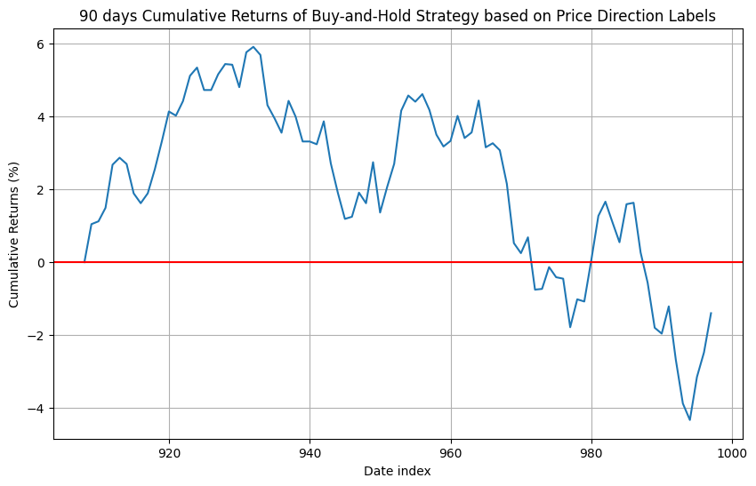
Return in 90 Days
Max Cumulative Returns%: 5.912780363654036
Min Cumulative Returns%: -4.3323408711213975
Average Daily Returns%: -0.015551017844626338
Average Cumulative Returns%: 2.0677014549450226
Last Day Cumulative Returns%: -1.3995916060163696

Slide 31
Return in 90 Days
Volatility:
0.7511581697904157
Sharpe Ratio:
-0.09139355811543791
Sortino Ratio:
-0.1375

Slide 32
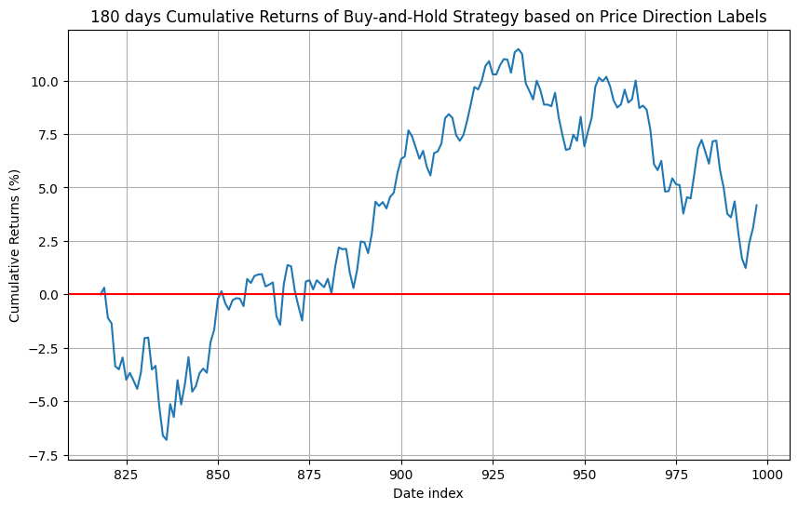
Return in 180 Days
Max Cumulative Returns%:
11.473957992747291
Min Cumulative Returns%:
-6.811354828546446
Average Daily Returns%:
0.0231211598442151
Average Cumulative Returns%:
3.808135527787115
Last Day Cumulative Returns%:
4.161808771958711

Slide 33
Return in 180 Days
Volatility:
0.812254965033174
Sharpe Ratio:
-0.036785050805524584
Sortino Ratio:
-0.0550

Slide 34
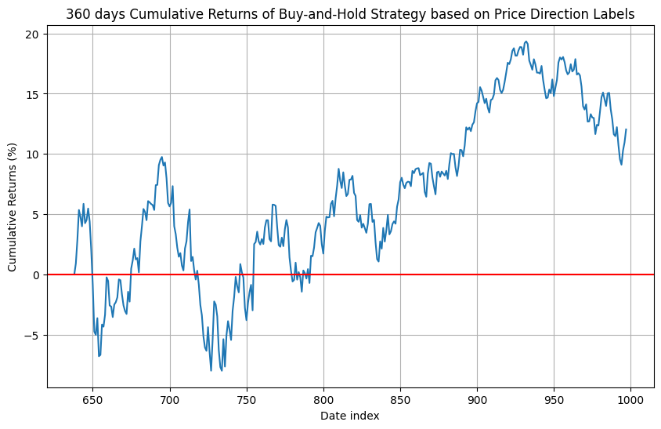
Return in 360 Days
Max Cumulative Returns%:
19.346248967424607
Min Cumulative Returns%:
-8.000618991356456
Average Daily Returns%:
0.03343259249400222
Average Cumulative Returns%:
6.5062254835147035
Last Day Cumulative Returns%:
12.0357332978408

Slide 35
Return in 360 Days
Volatility:
1.179850553276389
Sharpe Ratio:
-0.014720006239577811
Sortino Ratio:
-0.0239

Slide 36
Analysis and Insights

Slide 37
Analysis and Insights
Cumulative Returns Increase Over Time:
Max, min, and mean cumulative returns increase as the number of days increases suggests that, on average, the trading strategy tends to perform better over longer holding periods.
This aligns with the common understanding that short-term trading might be more volatile and subject to noise, while longer-term trends may offer more stable returns.
Robustness of the Model:
Kinds of consistently shows positive cumulative returns across different time periods, it suggests that the AdaBoost model is capturing some underlying patterns in the data that persist over longer horizons. This is a positive indication of the model's robustness.

Slide 38
Analysis and Insights
Sharpe Ratios
The negative Sharpe Ratios indicate that the strategy's returns are not compensating for the additional risk taken.
The fact that the Sharpe Ratio increases with longer time periods might suggest that, over those longer periods, the strategy is able to generate returns that, while still risky, are higher relative to the risk-free rate compared to shorter periods.

Slide 39
Analysis and Insights
Sortino Ratio
A risk-adjusted performance measure that focuses on the downside risk of an investment.
Similar to Sharpe Ratio, but instead of considering the total volatility of returns, it focuses only on the volatility of negative returns (downside deviation).
The higher the Sortino Ratio, the better, as it suggests a higher return for the level of downside risk.
A Sortino Ratio of 0 or negative suggests that the portfolio is not adequately compensating for the downside risk.

Slide 40
Challenges
and Limitations

Slide 41
Challenges and Limitations
Model Complexity
Overfitting: There's a risk of overfitting, especially if the model is too complex and captures noise in the training data, leading to poor generalization on unseen data.
Model Interpretability: Some machine learning models, like ensemble methods, might be less interpretable, making it challenging to explain their decisions.

Slide 42
Challenges and Limitations
Market Dynamics
Changing Market Conditions: Financial markets are dynamic, and conditions may change over time. A strategy that worked well historically might not perform as expected in the future due to evolving market dynamics.
Transaction Costs: The strategy might not account for transaction costs, such as brokerage fees and slippage, which could significantly impact returns.

Slide 43
Challenges and Limitations
Risk Management
Lack of Risk Management: The presented strategy may not include a comprehensive risk management approach, potentially exposing the portfolio to excessive risk.
Risk Tolerance: The strategy's risk level may not align with the investor's risk tolerance.
External Factors
Economic Events: External events, such as economic crises or geopolitical events, can significantly impact financial markets and may not be adequately considered in the strategy.

Slide 44
Suggestions
for Improvement

Slide 45
Suggestions for Improvement
Data Enhancement:
- Use predicted future features data to train the model make the model usable for future data instead of historical data
Feature Engineering:
- Explore additional features or technical indicators.
- Investigate the impact of alternative feature sets on model performance.

Slide 46
Suggestions for Improvement
Model Refinement:
- Experiment with hyperparameter tuning to optimize model performance.
- Consider trying additional machine learning models.
Extended Analysis:
- Perform sensitivity analysis on key parameters.
- Investigate the impact of transaction costs on returns.

Slide 47
Conclusion

Slide 48
Key Findings
Model Performance:
Our machine learning models showed commendable accuracy in predicting market trends. The performance on the test set aligns with expectations, showcasing the models' ability to generalize.
Trading Strategy:
Strategy driven by machine learning signals exhibited acceptable returns during backtesting. The directional changes-based approach provided a robust foundation for making buy and sell decisions; however still subject to loss at a certain time period.

Slide 49
Key Findings
Risk and Return Metrics:
The evaluation of the trading strategy's risk and return metrics, including Sharpe Ratio and Sortino Ratio, offered valuable insights into its overall performance. The strategy's effectiveness in generating positive returns was particularly evident over varying time horizons.

Slide 50
Challenges and Considerations
Model Robustness:
While the models performed well, continuous efforts are required to enhance their robustness, especially in the face of evolving market conditions.
Risk Management:
The absence of a sophisticated risk management mechanism, such as a stop-loss strategy, remains a limitation. Future iterations should explore advanced risk mitigation techniques.

Slide 51
Future Directions
1. Model Refinement:
Explore advanced machine learning models and ensemble techniques to further improve predictive accuracy.
2. Enhanced Risk Management:
Implement more sophisticated risk management strategies, incorporating dynamic position sizing and advanced risk metrics.

Slide 52
Future Directions
3. Real-Time Adaptability:
Develop mechanisms for real-time monitoring and adaptation to ensure the strategy remains effective in dynamic market environments.
4. Incorporate External Factors:
Consider incorporating external data sources and economic indicators to capture a more comprehensive view of market conditions.

Slide 53
References
U.S. daily treasury rates
https://home.treasury.gov/policy-issues/financing-the-government/interest-rate-statistics
S&P 500 and NASDAQ 100: Daily Data
https://www.kaggle.com/datasets/guillemservera/sp500-nasdaq-spy-qqq-ohlcv-data/
SPLG Daily Data
https://finance.yahoo.com/quote/SPLG/history?p=SPLG
Learn Exploratory Data Analysis (EDA) from Scratch
https://youtu.be/FNLLxYcUnow?si=jNdRlN7TavKqDMkf

Slide 54
End
Thank You!

